Slide 1
Outline
What subqueries are in DBMS
Syntax and usage of subqueries.
Differentiate between types of subqueries (single-row, multi-row, correlated).
Explore practical examples and common use cases.

Slide 2
Subqueries
Definition:
A subquery is a query nested inside another query (parent query).
It is used to perform intermediate calculations or fetch results that the main (outer) query uses.
Purpose:
To perform intermediate calculations.
To break complex queries into simpler ones.
To increase modularity and readability of SQL statements.
Syntax:
SELECT column1
FROM table1
WHERE column2 = (SELECT column1 FROM table2 WHERE condition);

Slide 3
Types of Subqueries – Single Row Subquery
Definition:
Returns only one row as a result. It is often used with comparison operators like =, <, >, etc.
Example: Find the employee with the highest salary.
SELECT name, salary
FROM employees
WHERE salary = (SELECT MAX(salary) FROM employees);

Slide 4
Types of Subqueries – Multi Row Subquery
Definition:
Returns multiple rows as a result. It is typically used with operators like IN, ANY, or ALL
Example: Find the employees who work in departments located in 'New York'.
SELECT name
FROM employees
WHERE department_id IN (SELECT department_id FROM departments WHERE location = 'New York');

Slide 5
Types of Subqueries – Multi-Column Subquery
Definition:
Returns multiple columns as a result. This can be used when comparing multiple values or for complex queries.
Example: Find the names and salaries of employees who work in the same department as 'John'.
SELECT name, salary
FROM employees
WHERE (department_id, job_title) = (SELECT department_id, job_title FROM employees WHERE name = 'John');

Slide 6
Types of Subqueries – Correlated Subquery
Definition:
A subquery that depends on the outer query for its values. It is executed repeatedly, once for each row in the outer query.
Example: Find employees whose salary is greater than the average salary of their department.
SELECT e1.name
FROM employees e1
WHERE e1.salary > (SELECT AVG(e2.salary)
FROM employees e2
WHERE e2.department_id = e1.department_id);

Slide 7
Types of Subqueries – Non-Correlated Subquery
Definition:
A subquery that is independent of the outer query. It is executed only once and provides the result to the outer query.
Example: Find employees earning more than the company's average salary.
SELECT name
FROM employees
WHERE salary > (SELECT AVG(salary) FROM employees);

Slide 8
Types of Subqueries – Nested Subquery
Definition:
A subquery inside another subquery, which can be nested multiple levels deep.
Example: Find employees working in departments located in cities where the company's headquarters is located.
SELECT name
FROM employees
WHERE department_id IN (SELECT department_id
FROM departments
WHERE location IN (SELECT city
FROM headquarters));

Slide 9
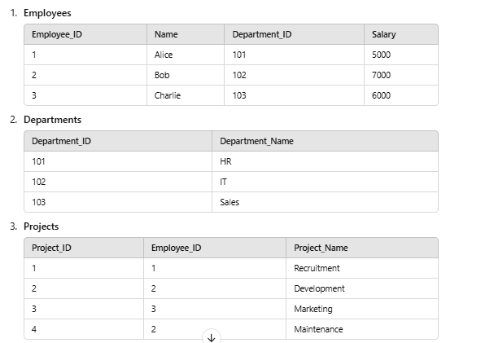

Slide 10
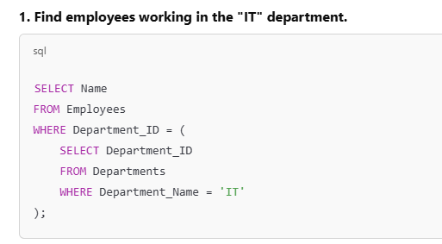
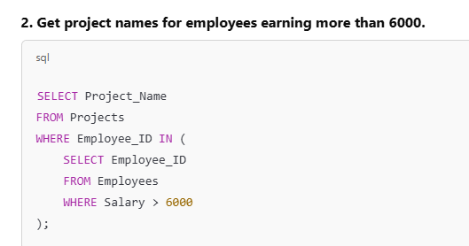
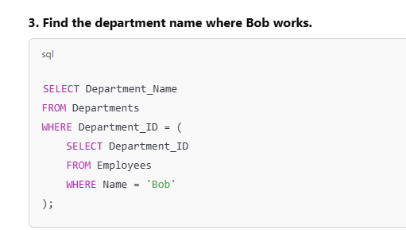
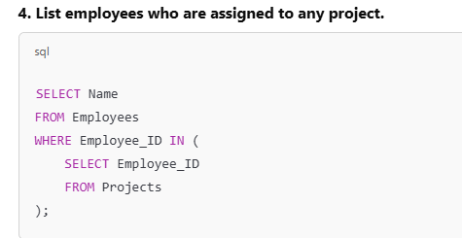

Slide 11
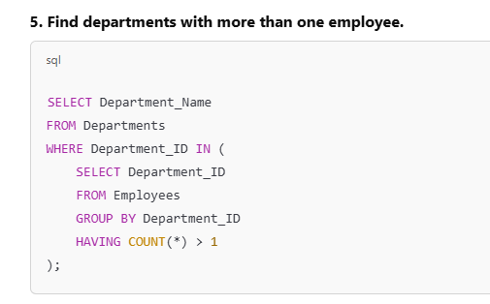
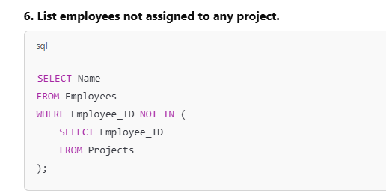
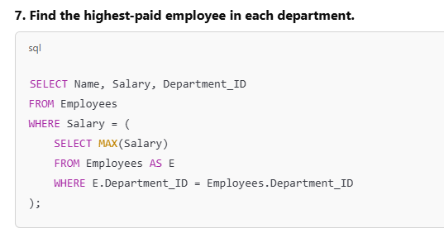
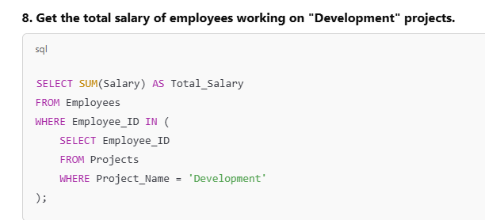

Slide 12
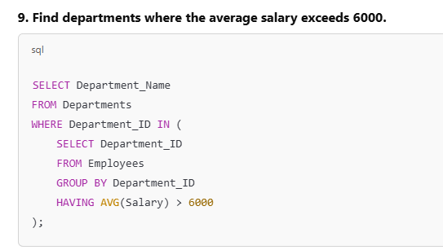
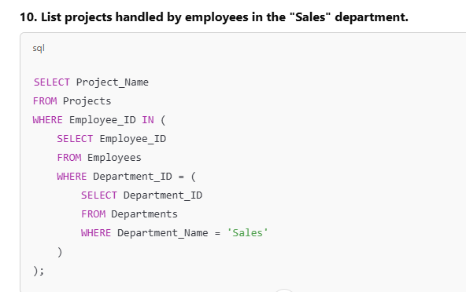
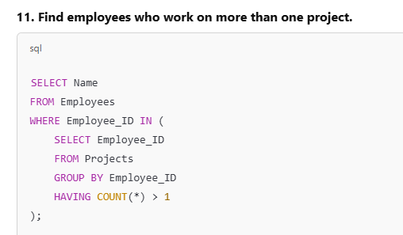

Slide 13
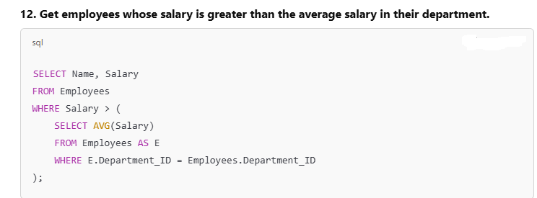
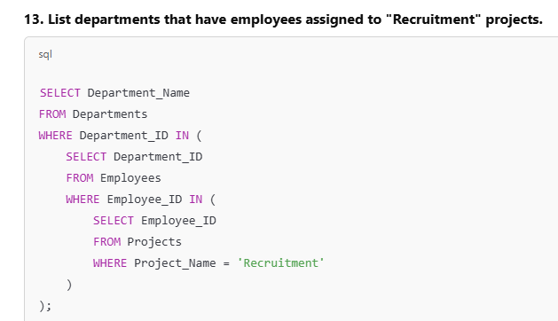

Slide 14
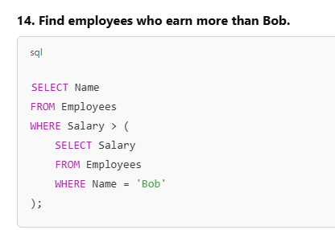
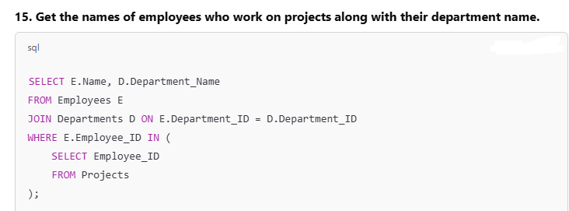

Slide 15
Thank You

